Slide 1
Stanford ME469: Nalu Suggested Homework #1 Discussion
Stefan P. Domino
Computational Thermal and Fluid Mechanics
Sandia National Laboratories SAND2018-4536 PE

Slide 2
Homework #1 Discussion: Outline
Discuss task 1: Nalu/reg_tests/test_files/dgNonConformalThreeBlade
Discuss task 2: Nalu/reg_tests/test_files/fluidsPmrChtPeriodic
Discuss task 3: specified pressure pipe flow
Wait… a significant departure from task 3
Simple time/convection MMS for P=1
Simple time/convection MMS for P=2
Back to the pipe!
Conclusions

Slide 3
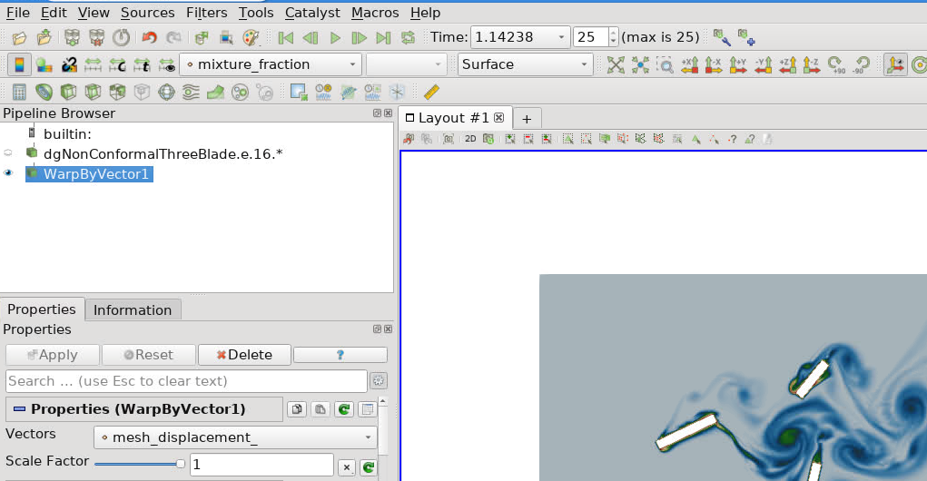
Answer for Homework #1, Task 1 of 3
Task 1: Run Nalu/reg_tests/test_files/dgNonConformalThreeBlade
Modify the input file to increase termination_step_count to ~500:
Visualize the flow field with displacements activated and provide a single image at the final step count.
How does modification of the blade rotation (omega) affect the time step?
time_stepping_type: adaptive
Courant# = U^{RTM}Δt/Δx with U^{RTM}=U-V^{mesh}
As V^{mesh} increases, Δt decreases to meet a fixed Courant number specification of 2
Report any modifications that resulted in catastrophic behavior, i.e., the simulation diverged. Document how you caused the simulation to diverge.
Too large of a time step given rotation, omega
Initial time step too large
No open bc specified (rendering flow a low-speed compressible configuration)
Time_Integrators:
- StandardTimeIntegrator:
name: ti_1
start_time: 0
termination_step_count: 500
time_stepping_type: adaptive
time_step_control:
target_courant: 2.0
time_step_change_factor: 1.15

Slide 4
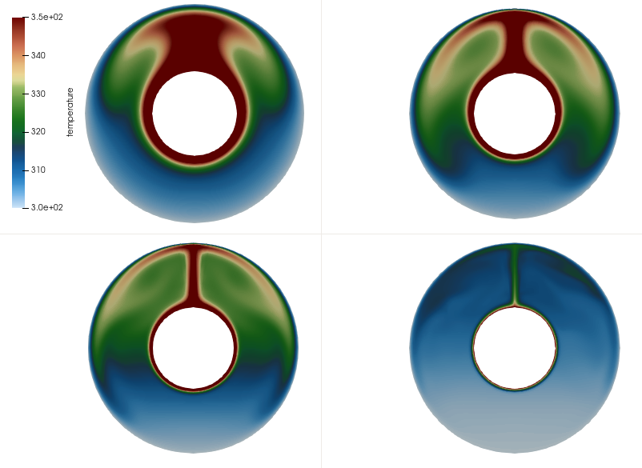
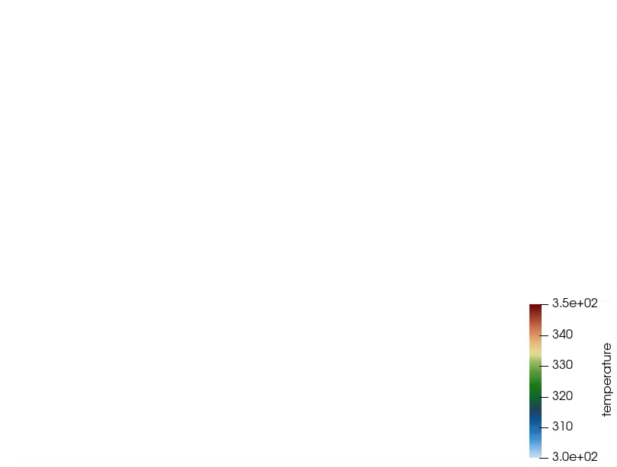
Answer for Homework #1, Task 2 of 3
Time_Integrators:
- StandardTimeIntegrator:
name: ti_1
start_time: 0
termination_step_count: 500
time_stepping_type: adaptive
Task 2: Run Nalu/reg_tests/test_files/fluidsPmrChtPeriodic
Modify the input file to increase termination_step_count to ~500.
Visualize the temperature, velocity, and radiative file (your choice) and provide a single image at the final step count.
Modify the gravity constant such that the Rayleigh number 10x, 100x, etc. Report any findings; does the code benefit from a modification of initial time step size?
Increased velocity magnitude from 0.16, 0.46, 1.5, and 3.7 m/s for gx1, gx10, gx100, gx1000
What happens if you change the velocity hybrid parameter to: velocity: 0.0
Far less advection stabilization is added. Former value of unity allows for velocity oscillations for cell Peclet number > 2
see: https://nalu.readthedocs.io/en/latest/source/theory/advectionStabilization.html
Ra = 10⁶
Ra = 10⁷
Ra = 10⁸
Ra = 10⁹
- user_constants:
gravity: [0.0, -9810.0, 0.0]
options:
- hybrid_factor:
velocity: 0.0
enthalpy: 1.0
Ra ~ 10⁹ velocity vector colored by temperature

Slide 5
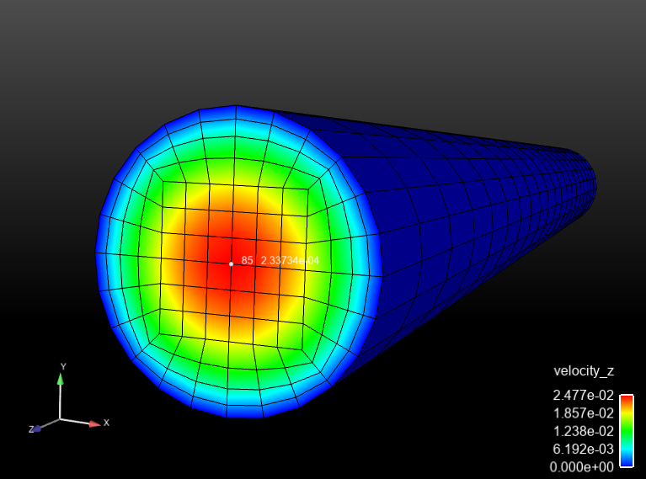
Answer for Homework #1 Task 3: Specified Pressure Drop Laminar Pipe Flow:
First, let’s think about this quadratic solution a bit more….

Slide 6
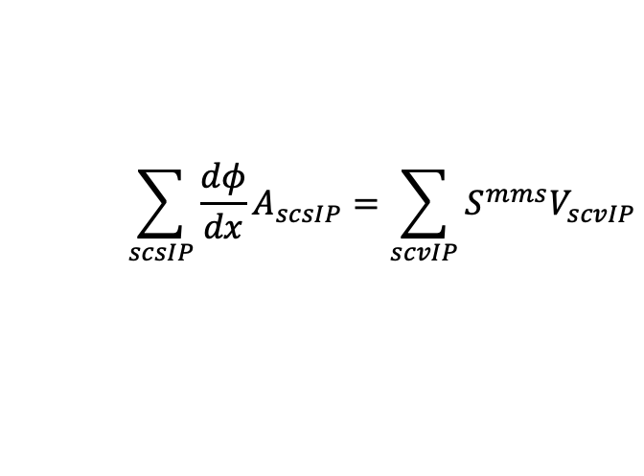
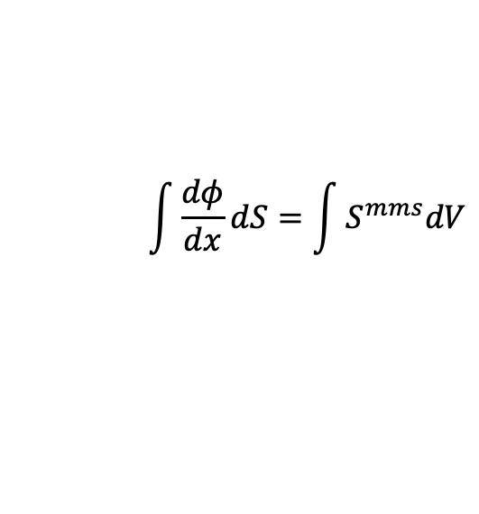
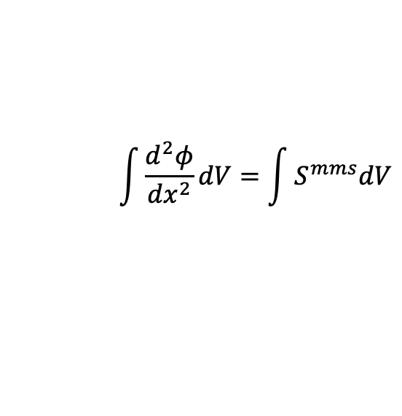
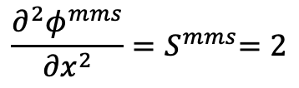
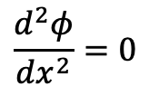
Simple One-D MMS Example; General Form
Consider a simple diffusion equation:
with a presumed, or manufactured solution:
$$\frac{d^{2}φ}{{dx}^{2}}=0$$
$$\frac{∂^{2}φ^{mms}}{{∂x}^{2}}{=S}^{mms}=2$$
Gauss-Divergence
$$\int{\frac{d^{2}φ}{{dx}^{2}}dV}=\int{S^{mms}dV}$$
$$\int{\frac{dφ}{dx}dS}=\int{S^{mms}dV}$$
Discrete flux-based form:
$$\sum_{scsIP}{\frac{dφ}{dx}A_{scsIP}=\sum_{scvIP}{S^{mms}V_{scvIP}}}$$
With error:

Slide 7
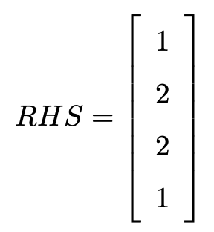
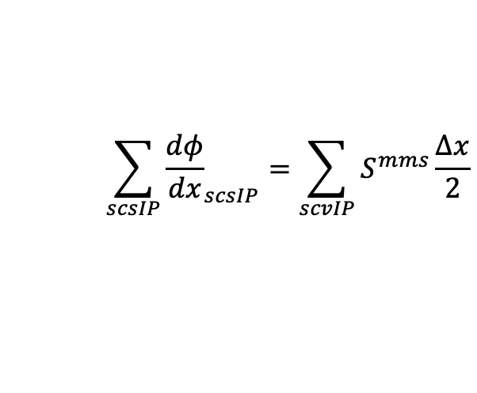
Simple One-D MMS Example; Nodal Assemble of Source Term
We will use a linear basis and solve this system over a small patch of linear bar elements
node = 0
1
Δx = 1
2
3
x
x
x
Boundary Conditions:
φ(x=0) = 0
φ(x=3) = 9
Recall general Eq:
Simplified 1-D equation (V_{scv} = A*Δx/2)
Node 0
$$\sum_{scsIP}{{\frac{dφ}{dx}}_{scsIP}=\sum_{scvIP}{S^{mms}\frac{∆x}{2}}}$$
Node 1
Node 2
First, assign lhs and rhs to zero, iterate subcontrol volume ips to assemble right-hand side source term:
Node 3

Slide 8
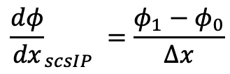
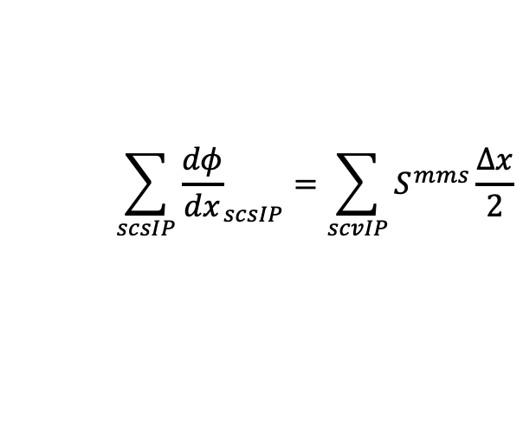
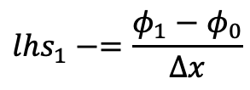
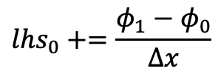
Simple One-D MMS Example; Edge-based Assemble of Diffusion
We will use a linear basis and solve this system over a small patch of linear bar elements
node = 0
1
Δx = 1
2
3
x
x
x
Recall, simplified equation with RHS from source term already provided
Iterate elements with a simple left-hand side rule: += L and -=R
(note implicit conservation statement)
$$\sum_{scsIP}{{\frac{dφ}{dx}}_{scsIP}=\sum_{scvIP}{S^{mms}\frac{∆x}{2}}}$$
0
1
x
$${lhs}_{0}+=\frac{φ_{1}−φ_{0}}{∆x}$$
Edge 1
$${\frac{dφ}{dx}}_{scsIP} =\frac{φ_{1}−φ_{0}}{∆x}$$
$${lhs}_{1}−=\frac{φ_{1}−φ_{0}}{∆x}$$

Slide 9
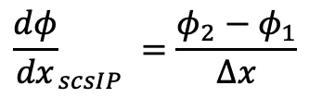
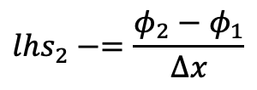
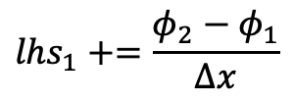
Simple One-D MMS Example; Edge-based Assemble of Diffusion
We will use a linear basis and solve this system over a small patch of linear bar elements
node = 0
1
Δx = 1
2
3
x
x
x
Recall, simplified equation with RHS from source term already provided
Iterate elements with a simple left-hand side rule: += L and -=R
(note implicit conservation statement)
$$\sum_{scsIP}{{\frac{dφ}{dx}}_{scsIP}=\sum_{scvIP}{S^{mms}\frac{∆x}{2}}}$$
1
2
x
$${lhs}_{1}+=\frac{φ_{2}−φ_{1}}{∆x}$$
Edge 2
$${\frac{dφ}{dx}}_{scsIP} =\frac{φ_{2}−φ_{1}}{∆x}$$
$${lhs}_{2}−=\frac{φ_{2}−φ_{1}}{∆x}$$

Slide 10
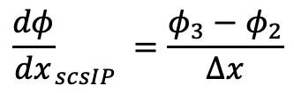
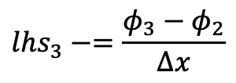
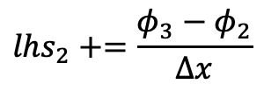
Simple One-D MMS Example; Edge-based Assemble of Diffusion
We will use a linear basis and solve this system over a small patch of linear bar elements
node = 0
1
Δx = 1
2
3
x
x
x
Recall, simplified equation with RHS from source term already provided
Iterate elements with a simple left-hand side rule: += L and -=R
(note implicit conservation statement)
$$\sum_{scsIP}{{\frac{dφ}{dx}}_{scsIP}=\sum_{scvIP}{S^{mms}\frac{∆x}{2}}}$$
2
3
x
$${lhs}_{2}+=\frac{φ_{3}−φ_{2}}{∆x}$$
Edge 3
$${\frac{dφ}{dx}}_{scsIP} =\frac{φ_{3}−φ_{2}}{∆x}$$
$${lhs}_{3}−=\frac{φ_{3}−φ_{2}}{∆x}$$

Slide 11
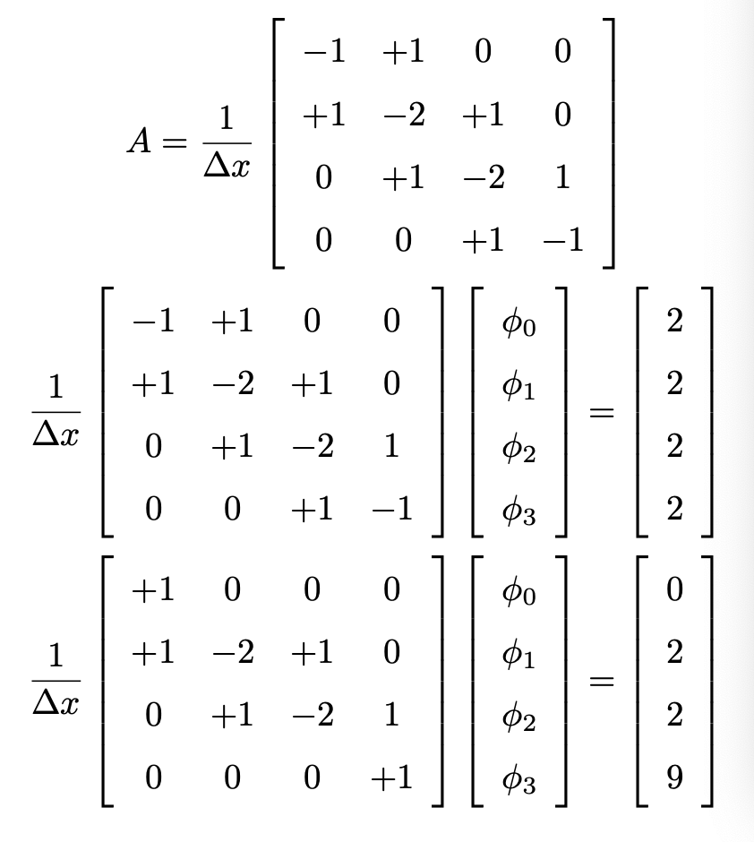
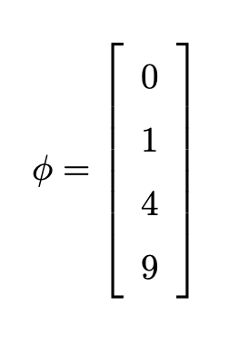
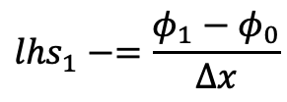
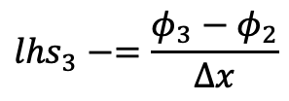
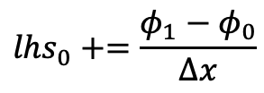
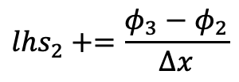
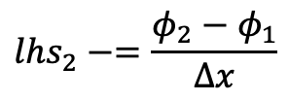
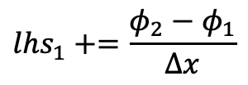
Simple One-D MMS Example; Collect all of the lhs entries
Fully assembled
matrix
$${lhs}_{0}+=\frac{φ_{1}−φ_{0}}{∆x}$$
$${lhs}_{1}−=\frac{φ_{1}−φ_{0}}{∆x}$$
Fully assembled
system
$${lhs}_{1}+=\frac{φ_{2}−φ_{1}}{∆x}$$
$${lhs}_{2}−=\frac{φ_{2}−φ_{1}}{∆x}$$
Correct for BCs
Correct for BCs:
$${lhs}_{2}+=\frac{φ_{3}−φ_{2}}{∆x}$$
$${lhs}_{3}−=\frac{φ_{3}−φ_{2}}{∆x}$$
Solution is exact….. Linear basis exactly captures a quadratic solution

Slide 12
Simple One-D MMS Example; General Form (New MMS)
Consider a simple diffusion equation:
with a presumed, or manufactured solution:
$$\frac{d^{2}φ}{{dx}^{2}}=0$$
$$\frac{∂^{2}φ^{mms}}{{∂x}^{2}}{=S}^{mms}=2$$
3x²
x³
Gauss-Divergence
$$\int{\frac{d^{2}φ}{{dx}^{2}}dV}=\int{S^{mms}dV}$$
$$\int{\frac{dφ}{dx}dS}=\int{S^{mms}dV}$$
Discrete flux-based form:
$$\sum_{scsIP}{\frac{dφ}{dx}A_{scsIP}=\sum_{scvIP}{S^{mms}V_{scvIP}}}$$
With error:

Slide 13
Simple One-D MMS Example; General Form (New MMS)
Consider a simple diffusion equation:
with a presumed, or manufactured solution:
$$\frac{d^{2}φ}{{dx}^{2}}=0$$
$$\frac{∂^{2}φ^{mms}}{{∂x}^{2}}{=S}^{mms}=2$$
3x²
4x³
x³
Gauss-Divergence
x⁴
$$\int{\frac{d^{2}φ}{{dx}^{2}}dV}=\int{S^{mms}dV}$$
$$\int{\frac{dφ}{dx}dS}=\int{S^{mms}dV}$$
Discrete flux-based form:
$$\sum_{scsIP}{\frac{dφ}{dx}A_{scsIP}=\sum_{scvIP}{S^{mms}V_{scvIP}}}$$
With error:

Slide 14

Simple One-D MMS Example; Quadratic CVFEM Assembly
We can use a quadratic basis and solve this system over a small patch of quadratic bar elements
node = 0
1
2
3
4
New promoted nodes “live” at the Gauss-Lobatto points while dual volume lives at the Gauss-Lagendre points: +/- sqrt(3)/3
Number of quadrature points for accurate integration scales as:
2*numPts – 1 = polynomial order
“2x2” quadrature will sufficiently integrate a quadratic basis
Using single point quadrature would provide results that simply replicate uniform refinement of the low-order mesh.
Replicating the previous example with the new basis would again demonstrate exact prediction of nodal results!
O(P) basis: O(Δx)^{P+1} accuracy

Slide 15
Example of a Quadratic Basis Function

Slide 16
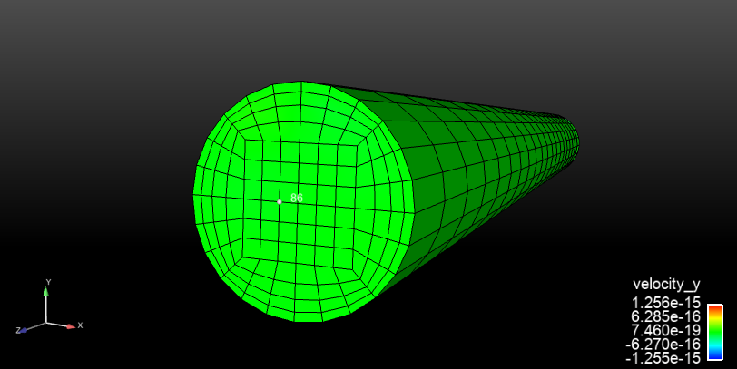
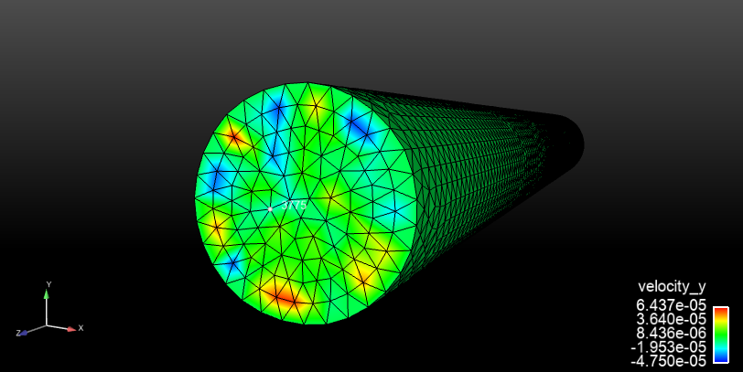
Answer for Homework #1 Task 3: Specified Pressure Drop Laminar Pipe Flow:
- open_boundary_condition: bc_left
target_name: surface_2
open_user_data:
pressure: 40.0e-4
velocity: [0.0,0.0,0.0]
- open_boundary_condition: bc_right
target_name: surface_1
open_user_data:
pressure: 0.0
velocity: [0.0,0.0,0.0]
Location: https://github.com/spdomin/Present/tree/master/stanfordMe469/hw/one
You will modify the input file to provide the density, viscosity and pressure drop to achieve Re^{τ} = 10 and report on the differences between the simulation and analytical centerline velocity.
Specifications:
Re^{τ} = 10
Pipe diameter, D = 0.01 m
Pipe Length, L = 0.1 m
Perform a global momentum balance to determine the pressure gradient. dp/dz as a function of the wall shear stress , τ_{w}.
Momentum Balance: dp/dz = 4 τ_{w} / D
Given Re^{τ} = ρ u^{τ} D / μ and τ_{w} = ρ (u^{τ})², where u^{τ} is the wall friction velocity, report the required pressure gradient required for the desired Re^{τ} = 10.
Δp/Δz = 40.0e-3 Pa/m with ΔZ = 0.1 m
Modify the input file to specify the proper density, viscosity and open pressure specification (look for the pressure specification under open_user_data).
ρ= 1.0 kg/m³ μ= 1.0e-5
Run both the Hex8 and Tet4 input file and compare the simulation centerline velocity to the analytical result (feel free to derive or simply report the functional form).
Analytical centerline is 2.5e-2 m/s
Close, however, not exact for this second-order functional form due to geometry errors.
Anyone try a 1x1x10 developing square pipe?
Capture any findings between the Hex8 and Tet4 simulation, e.g., simulation time, velocity component qualitative differences, convergence, etc.
Hex wall-normal velocity is O(1e-15) while Tet is O(1e-6) m/s
u(R) = u^{Max} [1-(r/R)²]
u^{Max} = Δp/Δz R² / (4 μ)

Slide 17
Pipe Flow Derivation

Slide 18
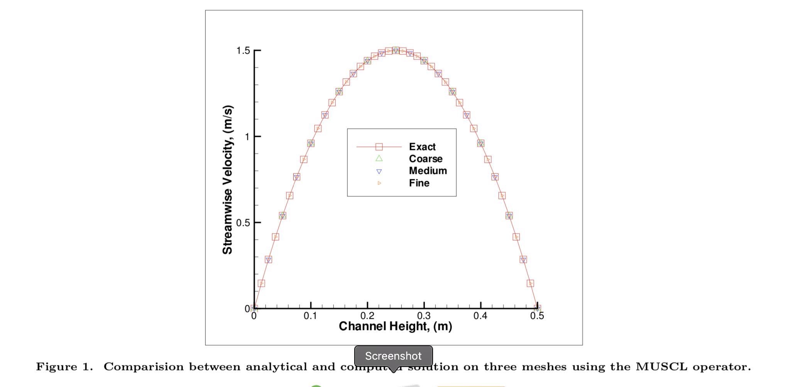
Convince Yourself! Removal of Geometric Error Induced by the Pipe
Domino et al., “Verification for Multi-Mechanics Applications ”, AIAA, 2007
BCs:
Note: A common norm methodology to alleviate this slight confusion is to integrate over the domain using a consistent mass matrix:
For P=1, this procedure interpolates the quadratic solution using the underlying basis and reverts to displaying a clear second-order error for ε vs Δx

Slide 19
Homework #1 Discussion: Conclusions
A P-order underlying polynomial basis will provide a P+1 integrated error
Geometric fidelity for complex geometries is required for accurate solutions

Slide 20
Homework #1 Discussion: A note on Art…
Georgia O’Keeffe, an American Artist: 1887-1986
Georgia O'Keeffe. Spring, 1948. Oil on canvas, 48 1/4 x 84 1/4 inches. Georgia O'Keeffe Museum. Gift of The Burnett Foundation. © Georgia O’Keeffe Museum. [1997.06.028]
https://www.kunm.org/post/landmark-okeeffe-painting-be-restored

Slide 21
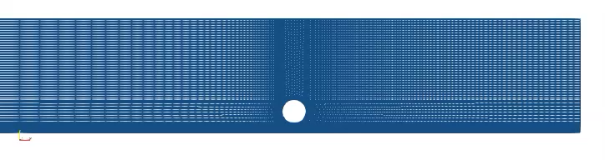

Homework #1 Discussion: A note on Art…
Who can create the best CFD art?

Slide 22
Element Integration: Physical Space
Let us define a linear basis over a representative one-dimensional bar element with iso-parametric range of ξ: -1:+1
-1
0
+1
x
N₁
N₂

Slide 23
Simple One-D MMS Example; General Form
Consider a simple time/convection equation:
with:
One-D; let ρ and u_{x} be constant and unity:
Gauss-Divergence
Discrete flux-based form:
With error:

Slide 24
Simple One-D MMS Example; Nodal Assemble of Source Term
We will use a linear basis and solve this system over a small patch of linear bar elements
node = 0
1
Δx = 1
2
3
x
x
x
Boundary Conditions:
φ(x=0) = 0
φ(x=3) = 9
Recall general Eq:
Simplified 1-D equation (unity density, x-velocity, and mesh spacing)
Node 0
First, assign lhs and rhs to zero, iterate nodes to assemble right-hand side source term (2x):
Node 1
Node 2
Node 3

Slide 25
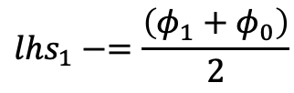
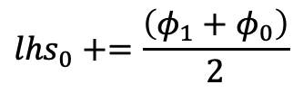
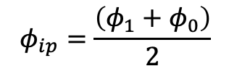
Simple One-D MMS Example; Edge-based assemble of convection
We will use a linear basis and solve this system over a small patch of linear bar elements
node = 0
1
Δx = 1
2
3
x
x
x
Recall, simplified equation with RHS from source term already provided
Iterate elements with a simple left-hand side rule: += L and -=R
(note implicit conservation statement)
0
1
x
$${lhs}_{0}+=\frac{\left(φ_{1}+φ_{0}\right)}{2}$$
Edge 1
$$φ_{ip}=\frac{\left(φ_{1}+φ_{0}\right)}{2}$$
$${lhs}_{1}−=\frac{\left(φ_{1}+φ_{0}\right)}{2}$$

Slide 26
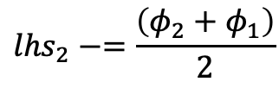
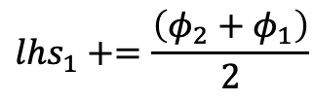
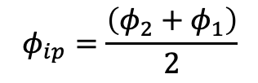
Simple One-D MMS Example; Edge-based assemble of convection
We will use a linear basis and solve this system over a small patch of linear bar elements
node = 0
1
Δx = 1
2
3
x
x
x
Recall, simplified equation with RHS from source term already provided
Iterate elements with a simple left-hand side rule: += L and -=R
(note implicit conservation statement)
1
2
x
$${lhs}_{1}+=\frac{\left(φ_{2}+φ_{1}\right)}{2}$$
Edge 2
$$φ_{ip}=\frac{\left(φ_{2}+φ_{1}\right)}{2}$$
$${lhs}_{2}−=\frac{\left(φ_{2}+φ_{1}\right)}{2}$$

Slide 27
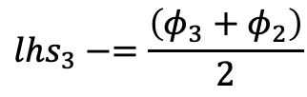
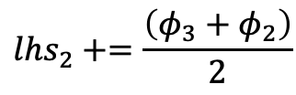
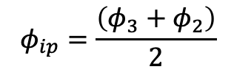
Simple One-D MMS Example; Linear CVFEM Assembly
We will use a linear basis and solve this system over a small patch of linear bar elements
node = 0
1
Δx = 1
2
3
x
x
x
Recall, simplified equation with RHS from source term already provided
Iterate elements with a simple left-hand side rule: += L and -=R
(note implicit conservation statement)
2
3
x
$${lhs}_{2}+=\frac{\left(φ_{3}+φ_{2}\right)}{2}$$
Edge 3
$$φ_{ip}=\frac{\left(φ_{3}+φ_{2}\right)}{2}$$
$${lhs}_{3}−=\frac{\left(φ_{3}+φ_{2}\right)}{2}$$

Slide 28
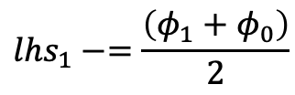
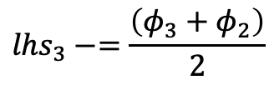
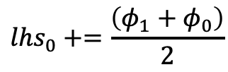
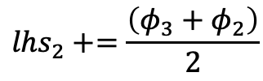
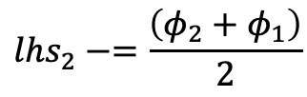
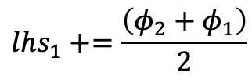
Simple One-D MMS Example; Collect all of the lhs entries
$${lhs}_{0}+=\frac{\left(φ_{1}+φ_{0}\right)}{2}$$
$${lhs}_{1}−=\frac{\left(φ_{1}+φ_{0}\right)}{2}$$
$${lhs}_{1}+=\frac{\left(φ_{2}+φ_{1}\right)}{2}$$
$${lhs}_{2}−=\frac{\left(φ_{2}+φ_{1}\right)}{2}$$
$${lhs}_{2}+=\frac{\left(φ_{3}+φ_{2}\right)}{2}$$
Correct for BCs:
Solution is exact!
$${lhs}_{3}−=\frac{\left(φ_{3}+φ_{2}\right)}{2}$$

Slide 29
Simple One-D MMS Example; General Form (new source)
Consider a simple time/convection equation:
with:
One-D; let ρ and u_{x} be constant and unity:
Gauss-Divergence
Discrete flux-based form:
With error:

